Slide 1
CMMI
The Capability Maturity Model (CMM) is a methodology used to develop & refine an org's software dev process. The model describes a five-level evolutionary path of increasingly organized & systematically more mature processes.
http://searchsoftwarequality.techtarget.com/definition/Capability-Maturity-Model

Slide 2
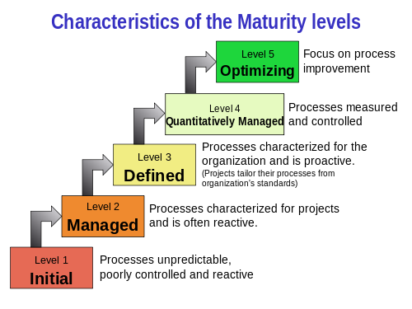
CMMI
https://en.wikipedia.org/wiki/Capability_Maturity_Model_Integration

Slide 3
CMMI
CMM was developed and is promoted by the Software Engineering Institute (SEI), a research and development center sponsored by the U.S. Department of Defense (DoD)
Now CMMI Institute (ISACA)
http://searchsoftwarequality.techtarget.com/definition/Capability-Maturity-Model

Slide 4
CMMI
The Capability Maturity Model Integration (CMMI®) is a performance improvement model for competitive organizations that want to achieve high-performance operations.
http://cmmiinstitute.com/about-cmmi-institute

Slide 5
CMMI
Building upon an org’s business performance objectives, CMMI provides a set of practices for improving processes, resulting in a performance improvement system that paves the way for better operations and performance.
http://cmmiinstitute.com/about-cmmi-institute

Slide 6
CMMI
More than any other approach, CMMI doesn’t just help to improve org processes. CMMI also has built-in practices that help to improve the way you use any performance improvement approach, setting you up to achieve a positive return on your investment
http://cmmiinstitute.com/about-cmmi-institute

Slide 7
CMMI
CMMI does not provide a single process. Rather, the CMMI provides guidance on what to do to improve your processes, not define your processes. CMMI is designed to compare an organization’s existing processes to proven best practices…
http://cmmiinstitute.com/about-cmmi-institute

Slide 8
CMMI
…developed by members of industry, govt, & academia; reveal possible areas for improvement; & provide ways to measure progress.
CMMI helps you to build & manage performance improvement systems that fit your unique environment.
http://cmmiinstitute.com/about-cmmi-institute

Slide 9
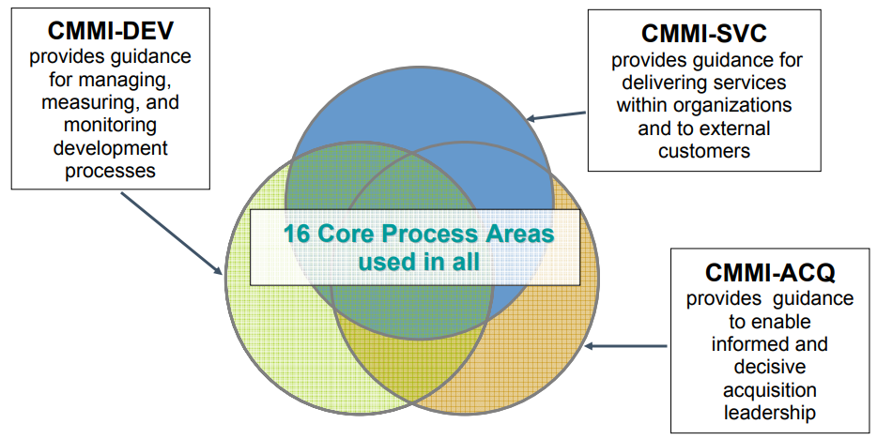
CMMI
THREE COMPLEMENTARY CONSTELLATIONS
http://www.sei.cmu.edu/library/assets/cmmi-overview071.pdf

Slide 10
CMMI
CMMI is a very well regarded framework especially in the software industry
Very useful for demonstrating process & quality capabilities to customers, partners, and investors
END

